Slide 1
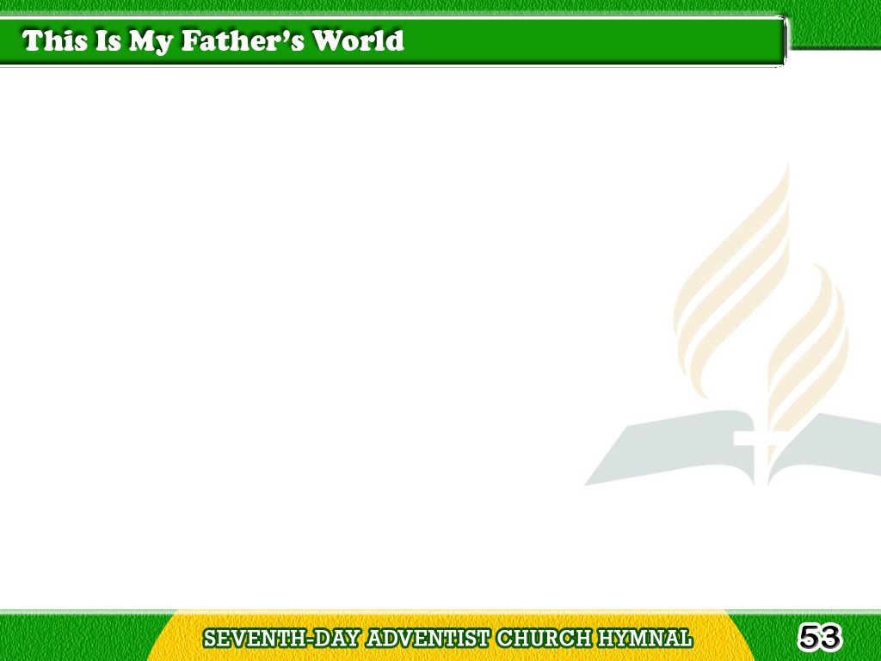
1/3
This is my Father’s world,
And to my listening ears,
All nature sings,
and round me rings
The music of the spheres.
Tagalog
Version

Slide 2
1/3
This is my Father’s world;
I rest me in the thought
Of rocks and trees,
of skies and seas;
His hand the wonders wrought.
Tagalog
Version

Slide 3
2/3
This is my Father’s world,
The birds their carols raise;
The morning light, the lily white,
Declare their Maker’s praise.
Tagalog
Version

Slide 4
2/3
This is my Father’s world;
He shines in all that’s fair;
In the rustling grass
I hear Him pass,
He speaks to me everywhere.
Tagalog
Version

Slide 5
3/3
This is my Father’s world,
O let me ne’er forget
That though the wrong
seems oft so strong,
God is the Ruler yet.
Tagalog
Version

Slide 6
3/3
This is my Father’s world;
Why should my heart be sad?
The Lord is King;
let the heavens ring!
God reigns; let the earth be glad.
Tagalog
Version

